Slide 1
Analytics-Driven Development
Karlo Zatylny

Slide 2


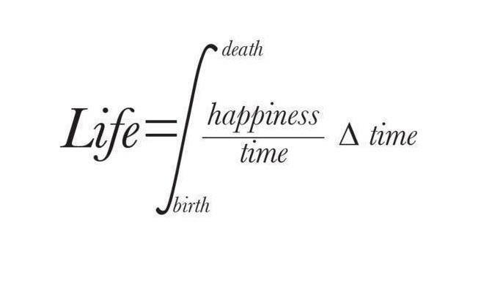

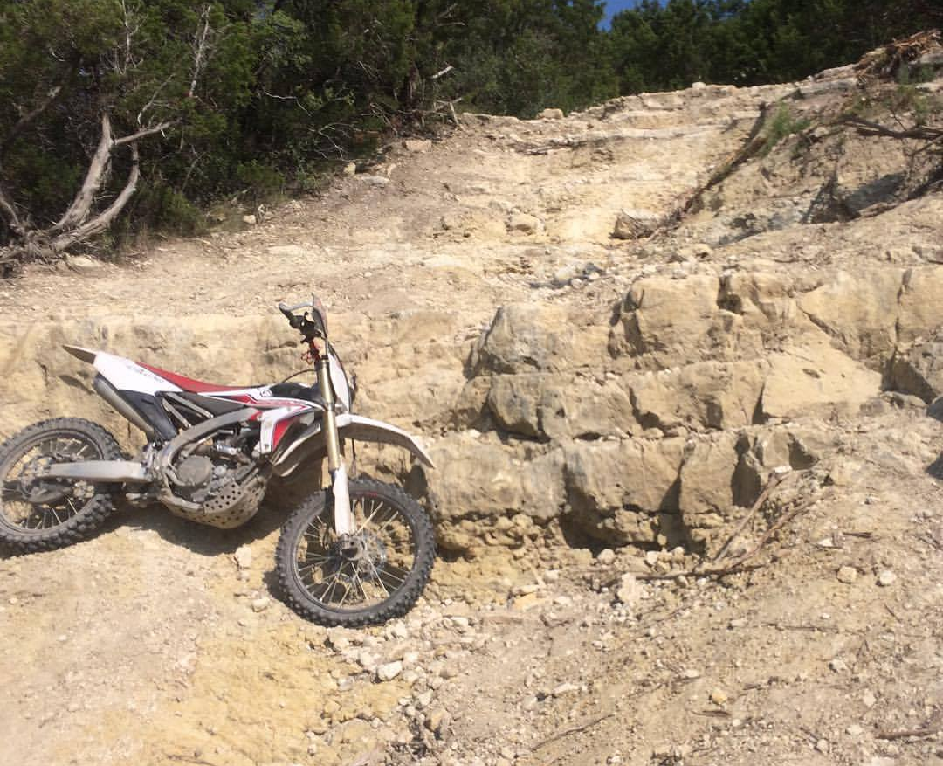

Who am I?
karlo.zatylny@solarwinds.com

Slide 3
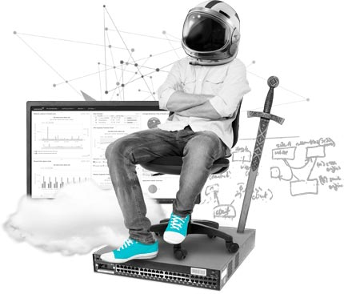
Leave Now!
Take aways:
Better monitoring through analyzing statistical data sets
Reduce overall system complexity
Cleaner data sets - reduced data sets
Gather intelligence, not data
Worldwide data grows at the same rate as landfill garbage
Next generation of computing is data-driven computing
Are your analytics facilitating the human or making decisions in place of the human?
P.S. Please use Google® during my presentation if you don’t know a word or phrase.

Slide 4

What do we do at SolarWinds?
We monitor the software you write and the hardware you build, which consists of:
Mostly reading available metrics exposed by APIs and protocols
Triggering alerts on user defined or calculated thresholds
Storing loads of data that no one ever sees or ultimately cares about

Slide 5

Order of operations: + - × ÷
What do you do when there is a problem in production?
Let’s solve this problem by using the big data none of us have the slightest idea what to do with…

Slide 6

Mom questions...
Why isn’t the printer printing?
The CPU is spiked. Why?
The software isn’t working. Why?
Why is the software slow?

Slide 7

Time Reproduce Logs Data Performance Counters More Logs
When did the problem start?
Which systems were affected?
What changed?
Can you reproduce the issue?
Can you send me the logs?
Can you run the diagnostics tool?

Slide 8
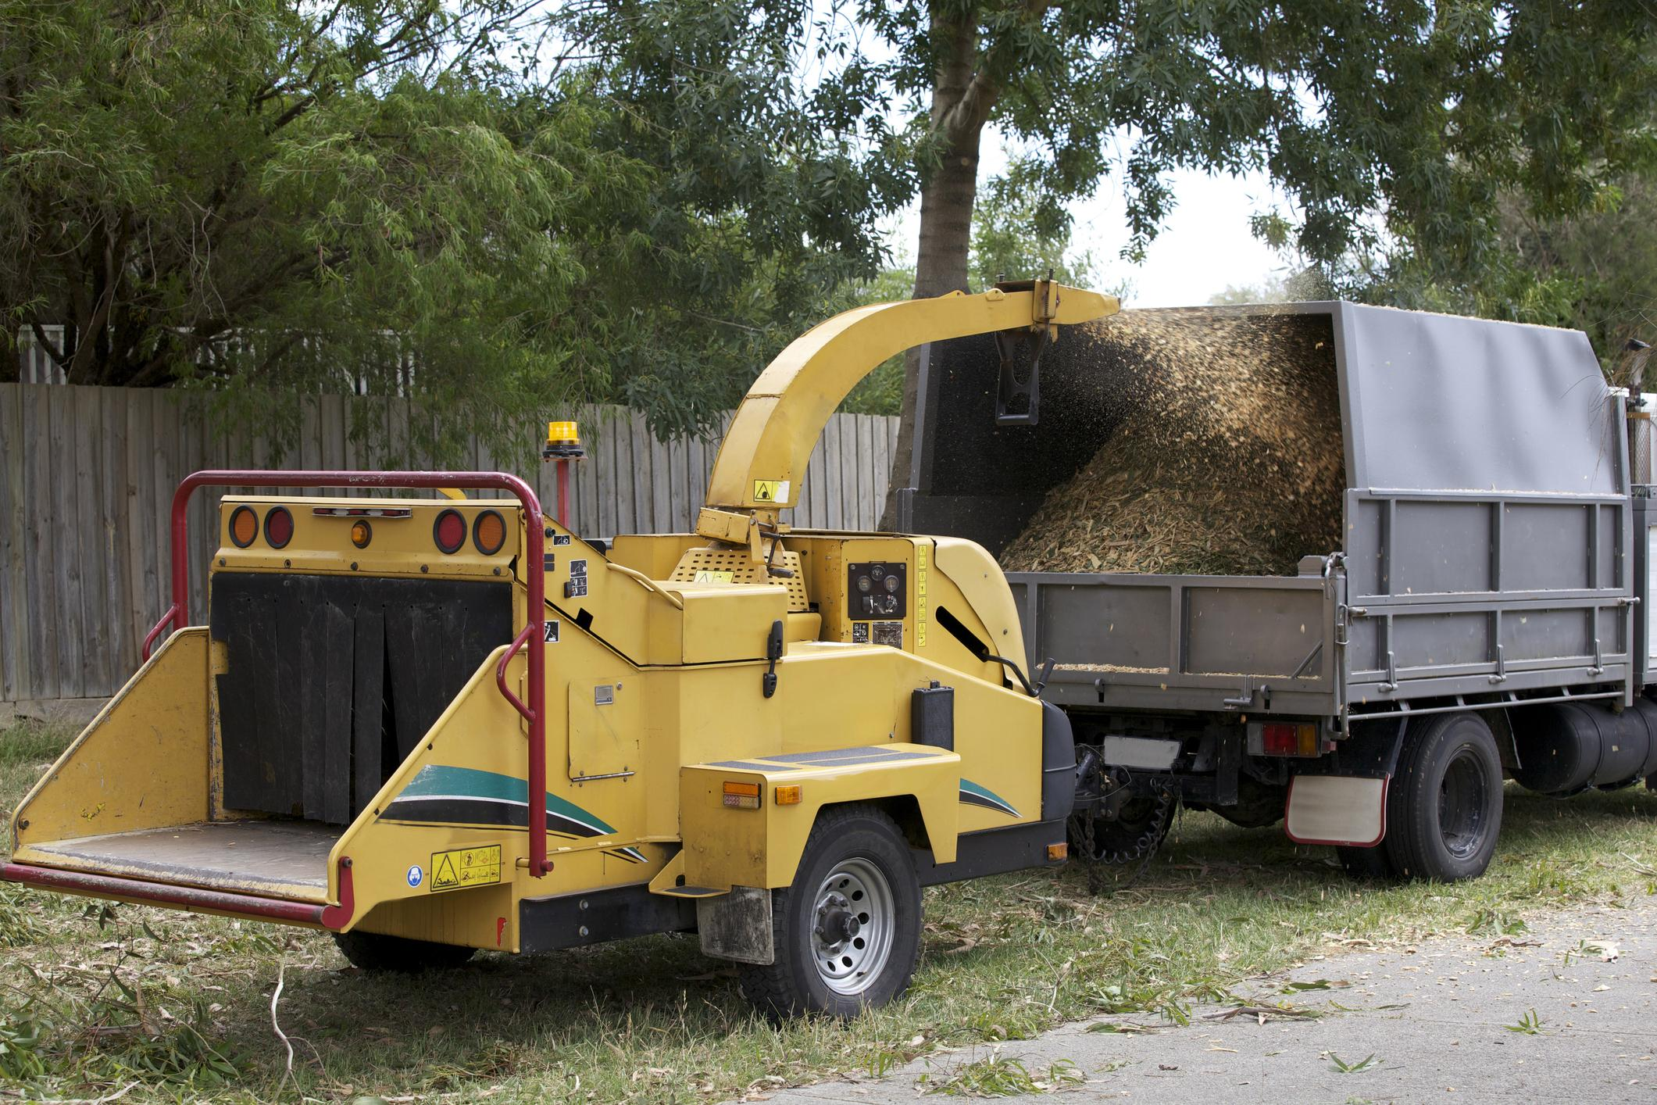
I am the Google search of my logs
Yay! You got the logs.
Let’s chip!
Luckily the system has 42 sets of logs that are not centralized.
Our system has centralized logs that create 500 MB of logs per minute.
I will search for “ERROR.”

Slide 9

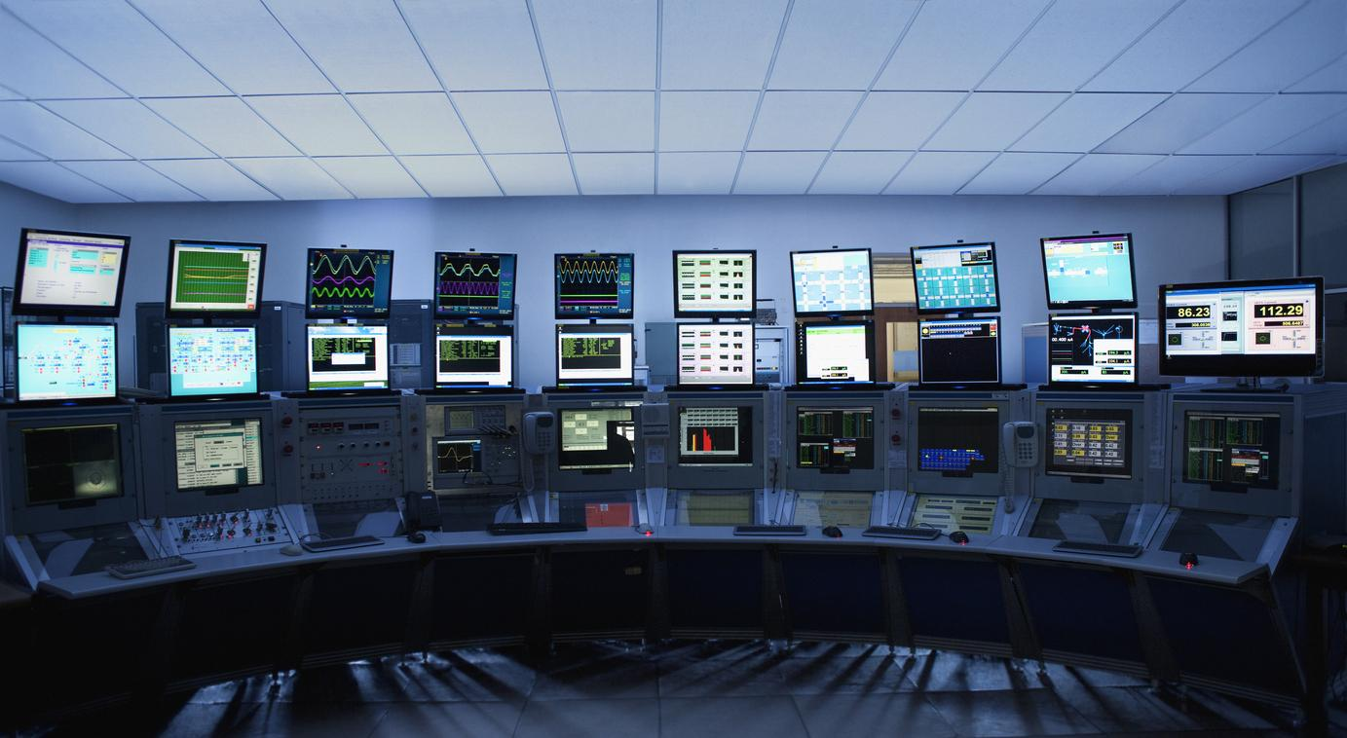
What is monitoring?
Monitoring is the active or passive gathering of numeric and text data for storage and analysis.
Steps:
Gather data
Analyze data
Trigger alerts on significant events
Execute remediation actions (email the admin)
What’s missing?
Solving the actual problem.

Slide 10
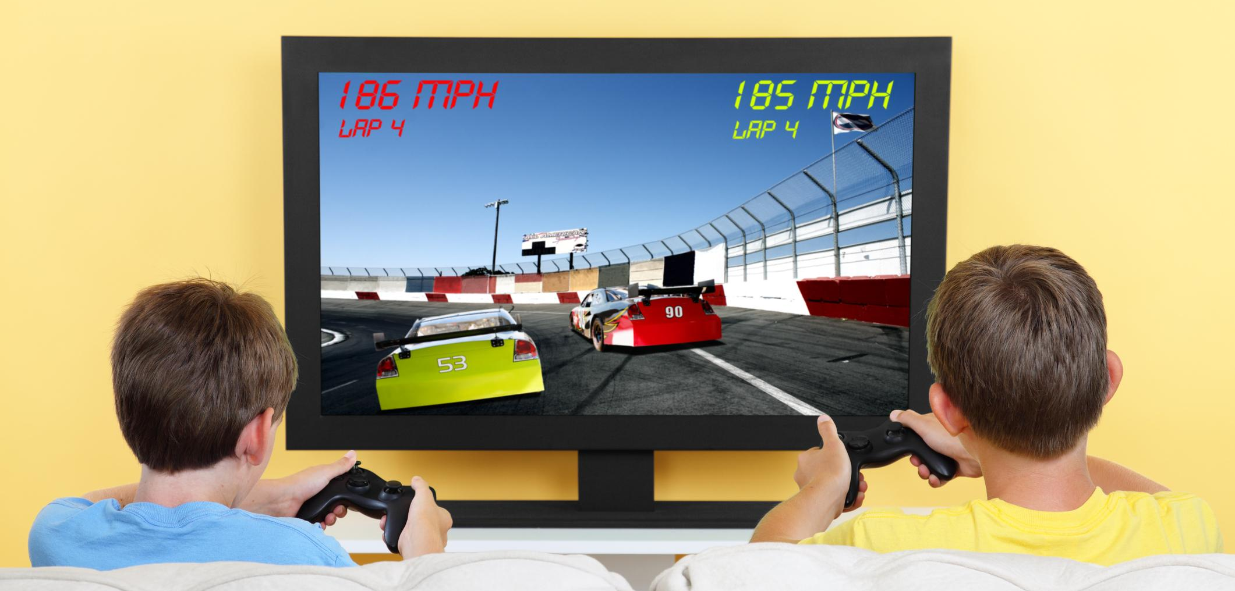
Prepare to be monitored
Metrics-Driven Development
Write your software in a way that is designed to be monitored
Instrument your code with metrics ready to give you critical data for:
Performance
Health
Troubleshooting
QUALIFYING ROUND
Provide an easy way for this data to be read
http://blog.librato.com/posts/2014/7/16/metrics-driven-development
http://blog.librato.com/posts/metrics-driven-development-2
https://www.infoq.com/articles/metrics-driven-development
https://sookocheff.com/post/mdd/mdd/
http://metrics.dropwizard.io/3.1.0/manual/core/

Slide 11
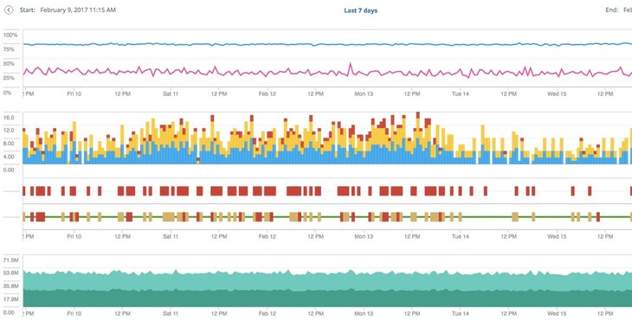
Data is not enough
Today, most systems pull or receive raw values and perform storage and analysis.
How do we improve this?
Random Sampling?
Distributed Storage?
ETL?
Parallelization?
MapReduce!?
Stream processing?

Slide 12
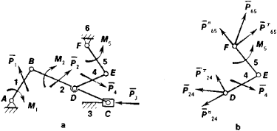
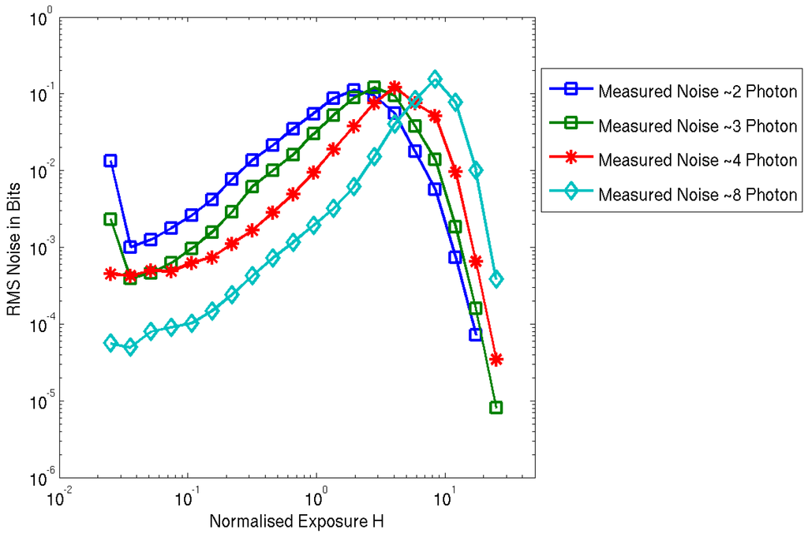
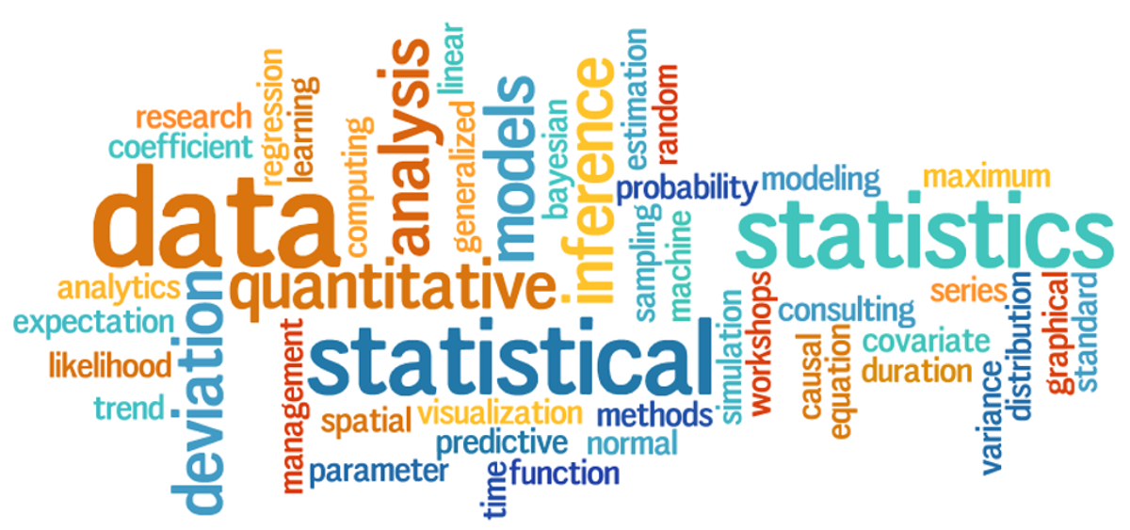
Analytics-Driven Development
Analyze! It’s easy. You learned it in college!

Slide 13

Statistics out of the box
In addition to providing a method to pull raw data from your system, provide basic statistical analysis.
Statsd and other agents often provide mean, std dev, and count as part of their data output
This should be extended:
mean, std dev, median, quartiles, median absolute deviation, skewness, kurtosis, linear regression trend, cardinality.
This should be time aware:
Date and time matter in our world, so day of week and
hour of day summaries should be stored and updated
168 buckets of data (168 = 24 * 7).

Slide 14
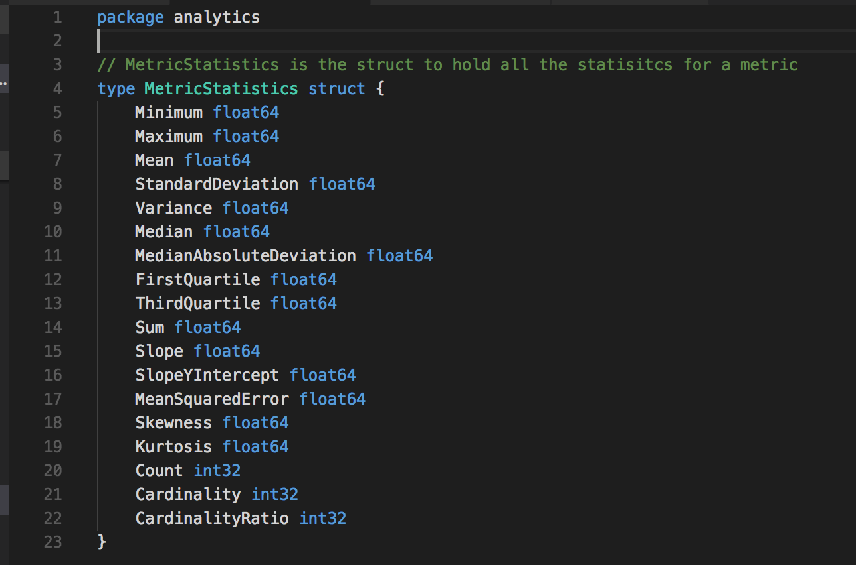
Metric statistics in GoLang coming to a GitHub® near you

Slide 15
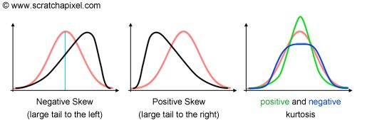
Why these statistics?
Cardinality - Low means Markov Chains and high means percentiles/statistical.
Skewness and Kurtosis - Find your strangeness to determine percentile or statistical.
Standard Deviation and Median Absolute Deviation - Zero is bad in either case and would eliminate either statistical or meaningful low percentile.
Median vs. Mean - Significant difference between the median and mean shows that percentiles are better.
Congratulations—you just did some machine learning!

Slide 16
Basic Analytics Decision Tree
Cardinality
Skewness & Kurtosis
Time Series Statistics
Statistical Analysis
Mean & Standard Deviation
Individual Measurement
Markov Chains & Proportionality
Median & Percentiles
Compare proportion of values and transition likelihood
Compare slope changes and movement of median
T Test and slope changes
Hourly Measurements
Anomalies

Slide 17

What to measure?
The Golden Metrics
Latency - how long operations are taking
Traffic - how much an operation is being used
Errors - how many times an operation is failing
Saturation - amount of capacity an operation is at
Every metric you add should help answer one of these four categories so that you can track and troubleshoot an issue. (See also RED method, TSA method, and USE method.)
Rates > Counters - Use counters to create rates. Rates can be compared statistically.
https://landing.google.com/sre/book/chapters/monitoring-distributed-systems.html#xref_monitoring_golden-signals
https://www.circonus.com/2017/08/system-monitoring-with-the-use-dashboard/
http://www.brendangregg.com/tsamethod.html

Slide 18
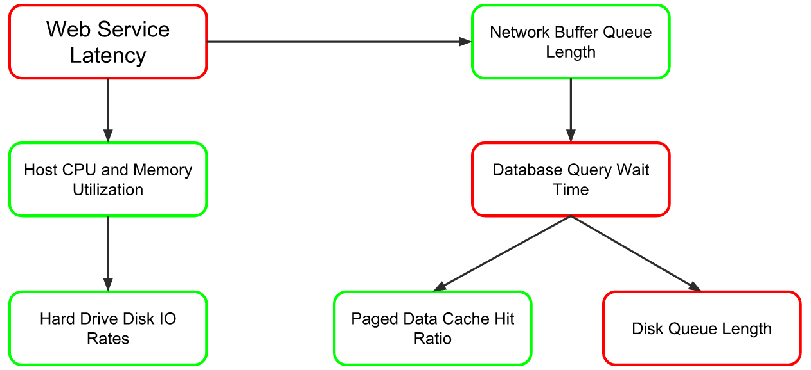
Relationships out of the box
Many metrics are dependent on other metrics within a system.
Metrics should have a hierarchical relationship mapped out by the developers to show relationships between metrics to help in root cause analysis.

Slide 19
Coding metrics like logging
Code currently gets instrumented with logging that is enabled by configuration for detail level
Metrics and performance counters are often always enabled
Proposal: run statistical calculations at levels similar to logging
Don’t spend CPU cycles when everything is okay.
Have relationships in place so that when something does go wrong then the analytics are ready.
Distributed analytics!
Everything a counter?
Everything a gauge? Make it a rate.
Your metric is not important unless you are the top level and you are latency.
Assume that you don’t need to do analytics and you should be a lower level.
Primary, Secondary, Tertiary - log analogs to Error, Information, Debug.

Slide 20

Save your 168
I want to store something!
Store your 168 hourly statistical summaries of your metrics
Fixed storage size
Predictable IO
Store your anomalies
This is a new compact data set!
New analytics, clustering, trending, machine learning

Slide 21

The new standard of metrics - REST API example
/metrics
Endpoint which GETs all the names of the metrics in the system
Metrics identified and described. e.g., data type, valid range, counter, importance
/metricsrelationships
Get the full hierarchy of metric relationships for the system
/metricsconfiguration
Configurations for sampling rates for statistical analysis and event stream thresholds
/metrics/{metric_name}
Gets the latest analytics including the last n raw data points and the calculated statistics
/metrics/{metric_name}/relationships
Gets all the child and parent relationships for that metric
/metrics/{metric_name}/{day_of_week}/{hour_of_day}
Return statistical analysis for the specified period

Slide 22
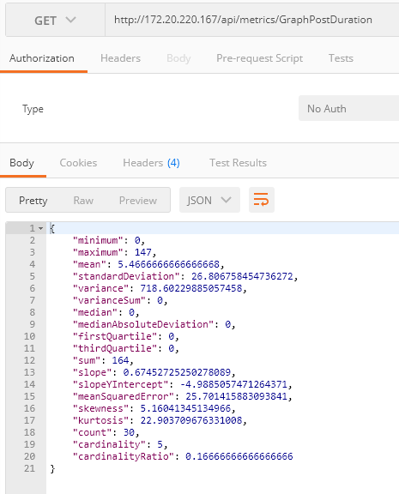
Sample call to a named metric

Slide 23
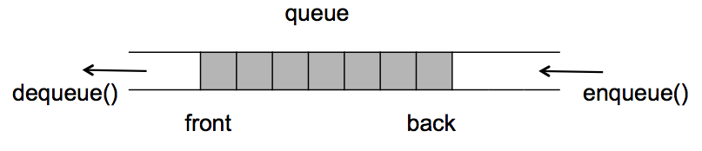
Sample Metric - Queue Length
I put my requests into a queue.
Common metric to measure: Queue Length
Issue: Queue Length doesn’t tell me how latent my operations are
Solution: Item in Queue Duration metric
Why: Tells me how long an item is in the queue, and therefore how much latency is being added to my operation because of my queue.
Solution 2: Queue and Dequeue Rates
Why: Tells me how many items per unit time my operation can handle, thus telling me a saturation measurement. Answers the question, “When is my operation full, or beyond its capacity?” or “When do I need to add a scaling component to my service?”

Slide 24

The doctor is in!
Health Checks
Give a meaningful health check with a numeric value
Health = Normalized Latency Health && Normalized Error Health && Normalized Traffic Health && Normalized Saturation Health (Max value of 1 where each gives a value of 0.25 max or 4 values of 1.0)
Avoid spikes by smoothing the last N measurements so that your health is general for recent history
https://github.com/kubernetes/community/blob/master/contributors/design-proposals/instrumentation/custom-metrics-api.md

Slide 25



Practical automated examples
Polling frequency - If you notice the latency in a certain device, don’t poll it at the default timeout. Give it a little more timeout and save timeout and retransmit expense.
Data size for error - If you notice a pattern where larger or smaller data set inputs creates an error case, then chunk your data and send larger or smaller data input to compensate.
Load balancing - If a certain service responses slower or with more errors, send it less traffic or kill it.

Slide 26

Future applications
Machine learning and deep learning algorithms can use hourly statistical summaries as input for neural networks to look at predicting alerts in the next hour.
Previous Hour Statistics
Magic
Next Hour Alert

Slide 27
Why don’t you just tell me what movie you want to see?
Event configuration allows for global or metric specific thresholds to allow for a push of events when a system metric is outside of a determined calculation range.
Monitoring systems then ingest events and query data only when necessary.
No need to read 5639 values of 2 from our disk queue length service
Stop storing unnecessary data
Passive monitoring

Slide 28

Summary
Prepare to be monitored
Instrument knowing how you will be analyzed
Analyze yourself!

Slide 29
Legal stuff that lawyers want me to show

